Slide 1

Indiana Department of Education (IDOE)
ILEARN and IREAD-3 Student Assessments
Request for Service 18-001
Pre-Proposal Conference
July 20th, 2017
12:30 PM
Eric Klinefelter, Deputy Director of Strategic Sourcing
Indiana Department of Administration

Slide 2
Agenda
General Information
Purpose of RFS
Key Dates
Proposal Preparation & Evaluation
Minority and Women’s Business Enterprises (M/WBE)
Question and Answer Session
Indiana Department of Administration

Slide 3
General Information
Sign-In Sheet for Attendees
Sign-In Sheet and PowerPoint will be posted on IDOA’s Solicitation Website
Hold questions until the end of the presentation
  Any verbal response is not considered binding; respondents are encouraged to submit any question formally in writing if it affects the proposal that will be submitted to the state.
  Additionally, the State will only be answering RFS process-related questions (i.e. how to fill out IDOA forms, etc.). No scope of work questions will be addressed.
Indiana Department of Administration

Slide 4
Purpose of the RFP
The purpose of this RFS is to select a vendor that can satisfy the State’s need for an ILEARN assessment and IREAD-3 assessment that meet the requirements of federal and/or state legislation and Indiana Administrative Code. The assessments will be aligned to Indiana Academic Standards, as adopted by the Indiana State Board of Education. It is the intent of Indiana Department of Education to contract with a vendor that provides quality assessments for the Office of Student Assessment.
Indiana Department of Administration

Slide 5
Term of RFP
Contract Term
  The term of the contract shall be for a period of three (3) years from the date of contract execution. There may be two (2) one-year renewals for a total of five (5) years at the State’s option.
Indiana Department of Administration

Slide 6
Key Dates
Activity | Date
Issue of RFP | July 13, 2017
Pre-Proposal Conference | July 20, 2017 at 12:30 PM EST
Deadline to Submit Written Questions | July 26, 2017 by 3:00 PM EST
Response to Written Questions/RFP Amendments | August 9, 2017
Submission of Proposals | August 24, 2017 by 3:00 PM EST
The dates for the following activities are target dates only. These activities may be completed earlier or later than the date shown.
Proposal Evaluation | August 30 – September 8, 2017
Proposal Discussions/Clarifications (if necessary) | August 30 – September 8, 2017
Oral Presentations (if necessary) | September 20 - 22, 2017
Best and Final Offers (if necessary) | September 28 – 29, 2017
Contract Award | October 2, 2017
Indiana Department of Administration

Slide 7
Business Proposal
(Attachment E)
Company Financial Information (Section 2.3.3)
  Confidential information must be kept separate from the proposal in both hard and soft copy
Contract Terms (Section 2.3.5)
  Respondent should review sample State contract and note exceptions to State mandatory and non-mandatory clauses in Transmittal Letter
Indiana Department of Administration

Slide 8
Technical Proposal
(Attachment F)
Please use the Template we have provided for you.
Where appropriate, supporting documentation may be referenced by a page and paragraph number.
Indiana Department of Administration

Slide 9
Cost Proposal
(Attachment D)
Cost scores will then be normalized to one another, based on the lowest cost proposal evaluated. The lowest cost proposal receives a total of 30 points. The normalization formula is as follows:
Respondent’s Cost Score = (Lowest Cost Proposal / Total Cost of Proposal) X 30
Indiana Department of Administration

Slide 10
Proposal Preparation
Buy Indiana, Business Proposal (2.3.14)
  – In compliance of Federal Code 2CFR 200.319 - this RFS/Contract contains federal funds and this preference may not be considered or applied.
Indiana Economic Impact, Attachment C
  Definition of FTE (Full-Time Equivalent)
  Example: If a Respondent has 5 full time employees and is bidding on its 5th contract, and all contracts get an equal amount of commitment from the employees then each employee commits 20% of his or her time to the new contract:
    0.2 x 5 employees= 1 FTE.
  While Indiana Preference is not part of scoring, this form is required.
Indiana Department of Administration

Slide 11
Proposal Preparation
Attachment D (Cost Proposal) must be returned in Excel
Use the templates provided for all answers
Do not alter templates
Submit all questions using template provided
Indiana Department of Administration

Slide 12
Proposal Evaluation
Summary of Evaluation Criteria:
Criteria | Points
Adherence to Mandatory Requirements | Pass/Fail
Management Assessment/Quality (Business and Technical Proposal) | 60 available points
Cost (Cost Proposal) | 30 available points
Minority Business Enterprise Subcontractor Commitment | 5 ( 1 bonus point is available, see Section 3.2.6)
Women Business Enterprise Subcontractor Commitment | 5 ( 1 bonus point is available, see Section 3.2.6)
Total | 100 (102 if bonus awarded)
Indiana Department of Administration

Slide 13
Minority and Women’s Business Enterprises
Complete Attachment A, MWBE Form
- Include sub-contractor letters of commitment
Goals for Proposal
- 8% Minority Business Enterprise
- 8% Women’s Business Enterprise
Indiana Department of Administration

Slide 14
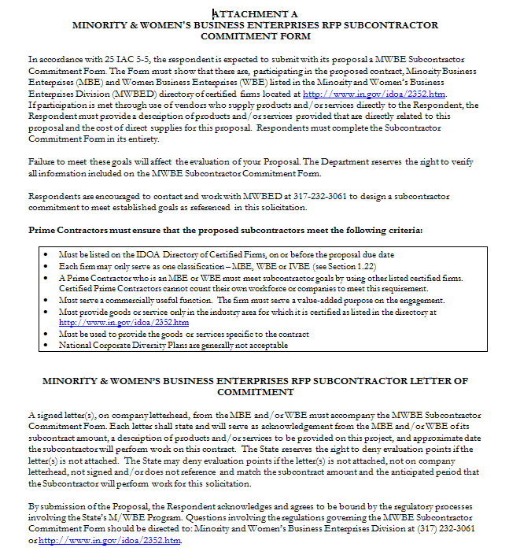
Indiana Department of Administration

Slide 15
Minority and Women’s Business Enterprises
Prime Contractors must ensure that the proposed subcontractors meet the following criteria:
Must be listed on the IDOA Directory of Certified Firms, on or before the proposal due date
Each firm may only serve as one classification – MBE, WBE or IVBE
A Prime Contractor who is an MBE or WBE must meet subcontractor goals by using other listed certified firms. Certified Prime Contractors cannot count their own workforce or companies to meet this requirement.
Must serve a commercially useful function. The firm must serve a value-added purpose on the engagement.
Must provide goods or service only in the industry area for which it is certified as listed in the directory at http://www.in.gov/idoa/2352.htm
Must be used to provide the goods or services specific to the contract
National Corporate Diversity Plans are generally not acceptable
Indiana Department of Administration

Slide 16
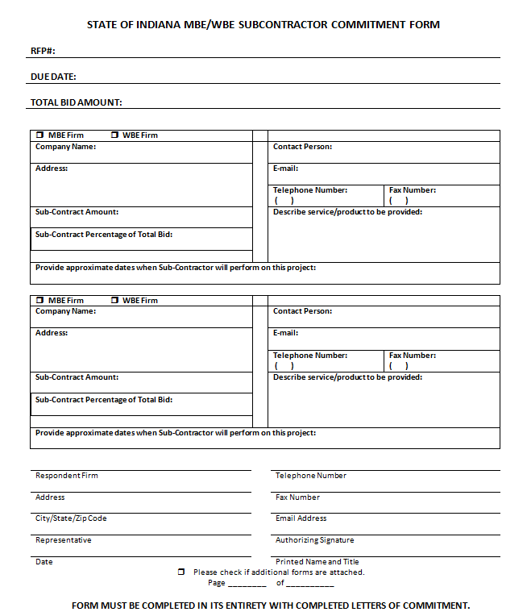
Indiana Department of Administration

Slide 17
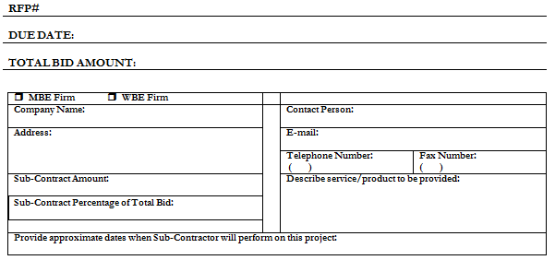
Minority and Women’s Business Enterprises
Indiana Department of Administration

Slide 18
Minority and Women’s Business Enterprises
Effective August, 2014, a new MWBE scoring methodology will be utilized for all RFP’s released
New Process – MWBE scoring is conducted based on 10 points plus a possible 2 bonus points scale
  MBE: Possible 5 points + 1 bonus point
  WBE: Possible 5 points + 1 bonus Point
Professional Services Scoring Methodology:
  The points will be awarded on the following schedule:
  Fractional percentages will be rounded up or down to the nearest whole percentage
  If the respondent’s commitment percentage is rounded down to 0% for MBE or WBE participation the respondent will receive 0 points.
  Submissions of 0% participation will result in a deduction of 1 point in each category
  The highest submission which exceeds the goal in each category will receive 6 points (5 points plus 1 bonus point). In case of a tie both firms will receive 6 points
% | 1% | 2% | 3% | 4% | 5% | 6% | 7% | 8%
Pts. | .625 | 1.25 | 1.875 | 2.5 | 3.125 | 3.75 | 4.375 | 5.0
Indiana Department of Administration

Slide 19
Minority and Women’s Business Enterprises
RFP MWBE Scoring Example
Bidder | MBE % | Pts. | WBE % | Pts. | Total Pts.
Bidder 1 | 12.0% | 5.0 | 10.0% | 6.0 | 11.0
Bidder 2 | 6.0% | 3.75 | 4.0% | 2.5 | 6.25
Bidder 3 | 8.0% | 5.0 | 8.0% | 5.0 | 10.0
Bidder 4 | 16.0% | 6.0 | 0.2% | 0.0 | 6.0
Bidder 5 | 0.0% | -1.0 | 0.0% | -1.0 | -2.0
Indiana Department of Administration

Slide 20
Additional Information
IDOA PROCUREMENT LINKS AND NUMBERS
http://www.in.gov/idoa/2354.htm
1-877-77BUYIN (8946) For Vendor Registration Questions
http://www.in.gov/idoa/2464.htm
For Inquiries Regarding Substantial Indiana Economic Impact
http://www.in.gov/idoa/2467.htm
Link to the developing “one stop shop” for vendor registry with IDOA and Secretary of State.
B. Secretary of State of Indiana:
Can be reached at (317) 232-6576 for registration assistance. www.in.gov/sos
C. See Vendor Handbook:
Online version available at http://www.in.gov/idoa/files/vendor_handbook.doc
Minority and Women Owned Business Enterprises:
http://www.in.gov/idoa/files/Certification_List(48).xls for table of IDOA certified MBEs and WBEs. For more WBE’s information http://www.in.gov/idoa/2352.htm
E. RFP posting and updates:
Go to http://www.in.gov/idoa/2354.htm (select “State of Indiana Opportunities” link)
Drag through table until you find desired RFP/RFI number on left-hand side and click the link.
Indiana Department of Administration

Slide 21
Questions
    Any verbal response is not considered binding; respondents are encouraged to submit any question formally in writing if it affects the proposal that will be submitted to the state.
Additionally, the State will only be answering RFS process-related questions (i.e. how to fill out IDOA forms, etc.). No scope of work questions will be addressed.
Indiana Department of Administration

Slide 22
Thank You
Eric Klinefelter
eklinefelter@idoa.IN.gov
Indiana Department of Administration

